Slide 1
ELEMENTS OF COMPUTING SYSTEMS-1 TOPIC: Representing numbers from 0-15 using two seven segment display decoders
Done by: AADITYA JAIN, ABIJITH PRADEEP, ADHITHAN PUSHPARAJ , ADITHYAN SUKUMAR

Slide 2
INTRODUCTION:
Our main aim is to represent numbers from 0-15 using two seven segment displays decoders. A seven-segment display is a form of electronic display device for displaying decimal numerals that is an alternative to the more complex dot matrix displays.
Seven-segment displays are widely used in digital clocks, electronic meters, basic calculators, and other electronic devices that display numerical information.
The materials we used are : 4 Breadboards, Jumper wires, 4 Button switches, ADALM1000, 2 seven segment display decoders, 6 IC-7408 chips, 6 IC-7432 chips, 1 IC-7486 chips, 1 IC-7404 chips.

Slide 3
How we did it ?
So first make the truth table for the numbers from 0-15. Then make the corresponding truth tables for both the displays. We used the first 7 segment BCD to display zero and one and the second 7 segment BCD to display the numbers from 0-15.Then obtain the simplified Boolean expressions using K-map from the truth tables.
Using these Boolean expressions we made a circuit and then made the connections according to it.

Slide 4
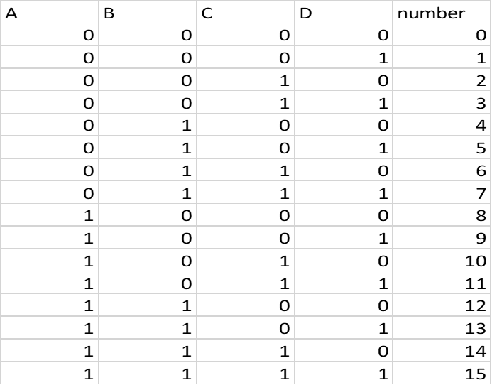
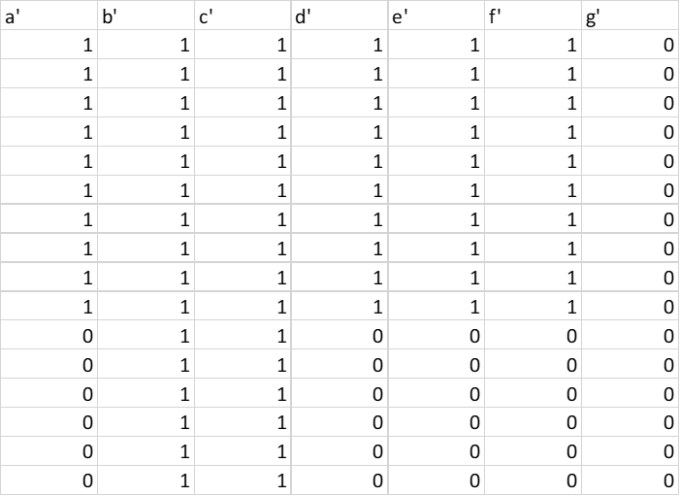
TRUTH TABLE:-

Slide 5
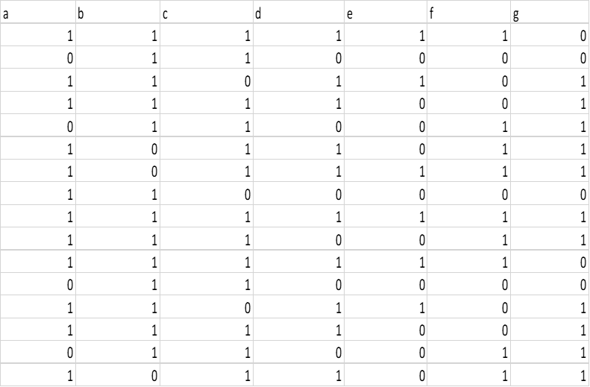

Slide 6
K-Map
a- c-
b- d-
 | C’.D’ | C’.D | C.D | C.D’
A’.B’ | 1 | 0 | 1 | 1
A’.B | 0 | 1 | 1 | 1
A.B | 1 | 1 | 1 | 0
A.B’ | 1 | 1 | 0 | 1
 | C’.D’ | C’.D | C.D | C.D’
A’.B’ | 1 | 1 | 1 | 0
A’.B | 1 | 1 | 0 | 1
A.B | 0 | 1 | 1 | 1
A.B’ | 1 | 1 | 1 | 1
 | C’.D’ | C’.D | C.D | C.D’
A’.B’ | 1 | 0 | 1 | 1
A’.B | 0 | 1 | 0 | 1
A.B | 1 | 1 | 1 | 0
A.B’ | 1 | 0 | 0 | 1
 | C’.D’ | C’.D | C.D | C.D’
A’.B’ | 1 | 1 | 1 | 1
A’.B | 1 | 0 | 1 | 0
A.B | 1 | 1 | 0 | 1
A.B’ | 1 | 1 | 1 | 1

Slide 7
e- g-
f-
 | C’.D’ | C’.D | C.D | C.D’
A’.B’ | 1 | 0 | 0 | 1
A’.B | 0 | 0 | 0 | 1
A.B | 1 | 0 | 0 | 0
A.B’ | 1 | 0 | 0 | 1
 | C’.D’ | C’.D | C.D | C.D’
A’.B’ | 0 | 0 | 1 | 1
A’.B | 1 | 1 | 0 | 1
A.B | 1 | 1 | 1 | 1
A.B’ | 1 | 1 | 0 | 0
 | C’.D’ | C’.D | C.D | C.D’
A’.B’ | 1 | 0 | 0 | 0
A’.B | 1 | 1 | 0 | 1
A.B | 0 | 0 | 1 | 1
A.B’ | 1 | 1 | 0 | 1

Slide 8
 | C’.D’ | C’.D | C.D | C.D’
A’.B’ | 1 | 1 | 1 | 1
A’.B | 1 | 1 | 1 | 1
A.B | 0 | 0 | 0 | 0
A.B’ | 1 | 1 | 0 | 0
 | C’.D’ | C’.D | C.D | C.D’
A’.B’ | 1 | 1 | 1 | 1
A’.B | 1 | 1 | 1 | 1
A.B | 1 | 1 | 1 | 1
A.B’ | 1 | 1 | 1 | 1
a’- c’-
b’- d’-
 | C’.D’ | C’.D | C.D | C.D’
A’.B’ | 1 | 1 | 1 | 1
A’.B | 1 | 1 | 1 | 1
A.B | 1 | 1 | 1 | 1
A.B’ | 1 | 1 | 1 | 1
 | C’.D’ | C’.D | C.D | C.D’
A’.B’ | 1 | 1 | 1 | 1
A’.B | 1 | 1 | 1 | 1
A.B | 0 | 0 | 0 | 0
A.B’ | 1 | 1 | 0 | 0

Slide 9
 | C’.D’ | C’.D | C.D | C.D’
A’.B’ | 1 | 1 | 1 | 1
A’.B | 1 | 1 | 1 | 1
A.B | 0 | 0 | 0 | 0
A.B’ | 1 | 1 | 0 | 0
e’- g’-
f’-
 | C’.D’ | C’.D | C.D | C.D’
A’.B’ | 0 | 0 | 0 | 0
A’.B | 0 | 0 | 0 | 0
A.B | 0 | 0 | 0 | 0
A.B’ | 0 | 0 | 0 | 0
 | C’.D’ | C’.D | C.D | C.D’
A’.B’ | 1 | 1 | 1 | 1
A’.B | 1 | 1 | 1 | 1
A.B | 0 | 0 | 0 | 0
A.B’ | 1 | 1 | 0 | 0

Slide 10
BOOLEAN EXPRESSIONS:

Slide 11
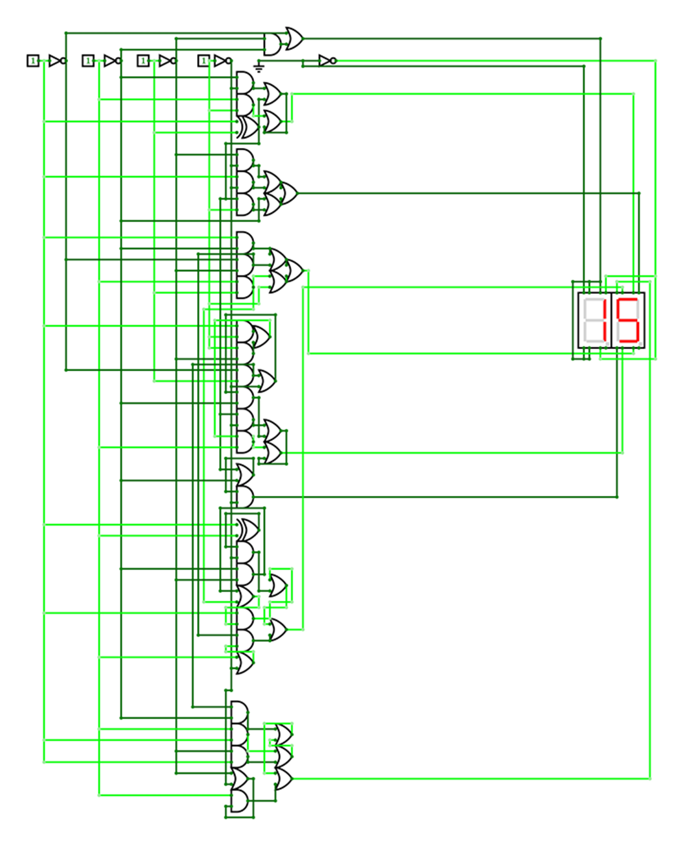
CIRCUIT DIAGRAMS:

Slide 12
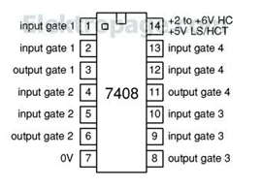
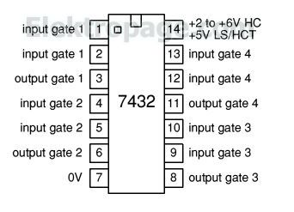
PIN DIAGRAMS:
AND Gate IC 7408: OR Gate IC 7432:

Slide 13
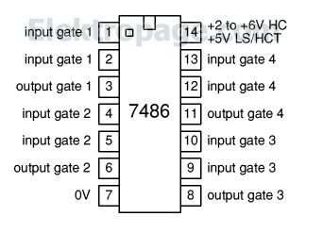
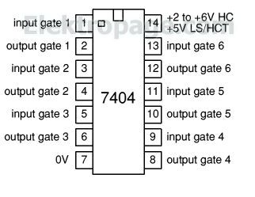
XOR Gate IC 7486: NOT Gate IC 7404:

Slide 14
THANK YOU

